Slide 1
Glioblastoma RNAseq mortality prediction via ML model.
Miguel A. Cuevas
U0624889
BMI 6015

Slide 2
Goal
Train model(s) to identify clinically significant transcripts in GBM.
Common transcripts over or under expressed in living vs diseased patients.
Identify transcripts at individual level for targeted therapy.

Slide 3
Literature
Few examples use ML on RNA seq samples.
Include :
Machine Learning Model for Lymph Node Metastasis Prediction in Breast Cancer Using Random Forest Algorithm and Mitochondrial Metabolism Hub Genes
Byung-Chul Kim 1 , Jingyu Kim 2 , Ilhan Lim 1 , Dong Ho Kim 3 , Sang Moo Lim 1 and Sang-Keun Woo 2,4,*
Predict metastasis from rna seq expression.
Focused on Single-cell RNA seq of breast cancer tissue.
Used data from Gene Expression Omnibus database.
Model built using Random Forest Algorithm using 54 selected genes.
Validated using an external dataset of from TCGA
Showed 91 percent accuracy

Slide 4
Literature
Some use Microarray RNAseq vs RNAseq
Machine Learning Model for Cancer Diagnosis based on RNAseq Microarray
Hanaa` Torkey1; Mostafa Samy Atlam email 2; Nawal El-Fishawy3; Hana Salem4
Studied various models including SVM,DT,KNN,NB combined with PCA vs LDA and FA.
Trained using Microarray RNA seq from various cancers and validated with TCGA dataset.
Focused on finding best dimensionally reduction.
Best model determined to be Linear SVM.

Slide 5
Literature
And few use all rnaseq to identify cancer subset.
Cancer classification of single-cell gene expression data by neural network
Bong-Hyun Kim1,2,†, Kijin Yu1 and Peter C. W. Lee 1,*
“Our cancer classifiers, which are able to classify normal single cells and cancer cells, as well as predict different cancer types, can be helpful in cancer diagnosis through liquid biopsy.”
Five ML models were trained with 12 different gene set sizes from 22 phenotypes—21 cancer samples and 1 normal type.
NN, at 300 significant genes, resulted in the best performance with MCC 0.89 and ACC 0.9
kNN was the worst classifier with MCC 0.71 (Fig. 3B and Supplementary Fig. S1B).
In pan-cancer classification, L-SVM (MCC 0.87) and RF (MCC 0.86) perform more accurately than binary classification, and NN (MCC 0.89), RBF-SVM (MCC 0.87) and kNN

Slide 6
Discussion of Literature
None attempt to predict which gene transcripts determine mortality.
Classifying the cancer type is a great start to help patients.
More can be done.
Identifying which specific transcripts are up and down regulated can
Determine targeted therapies for each individual
Further elucidate cancer mechanisms
Classify cancer subtypes based on populations clinical subsets.

Slide 7
Data
RNAseq data from GBM patient’s tumor samples.
Clinical information
Including gender, age, living status, treatment type etc.
~148 patients
~62000 transcript rna seq counts
Standardized via FPKM

Slide 8

Data processing
Using DAVID (Database for Annotation, Visualization and integrated Discovery) ontology, created subsets based on functional annotation grouping.
Groupings include Positive regulation of apoptosis, transport genes etc.
Total of 31 groupings
18000 genes did not belong to any grouping and were not used.
Data matrix was assembled from raw counts per patient.
Final matrix consisting of Patients on the x axis and transcript counts on the y axis.
Clinical data was then appended, with values on x and labels on y.
Y predicted value was living status living(0), diseased(1).
Column moved to last column in data matrix.
Patients with missing values were removed.
Data could not be filled in using any statistical method such as average.

Slide 9
ML methodology
Standardization: not needed as data was already standardized using FPKM.
Performed 80-20 split and 1 holdout validation.
Selected XGBoost classifier.
RandomizedSearchCV on XGBoost params
Ordinal encoding on x values.
Label encoding on y values.
0 = living, 1 diseased for y values.

Slide 10
Clinical only model
ClinXGBClassifier(average='micro', base_score=0.5, booster='gbtree', colsample_bylevel=1, colsample_bynode=1, colsample_bytree=1, enable_categorical=False, eval_metric='logloss', gamma=0, gpu_id=-1, importance_type=None, interaction_constraints='', learning_rate=0.300000012, max_delta_step=0, max_depth=2, min_child_weight=1, missing=nan, monotone_constraints='()', n_estimators=10, n_jobs=16, num_class=8, num_parallel_tree=1, objective='multi:softmax', predictor='auto', random_state=1, reg_alpha=0, reg_lambda=1, scale_pos_weight=None, subsample=1, tree_method='exact', ...)ical only model

Slide 11
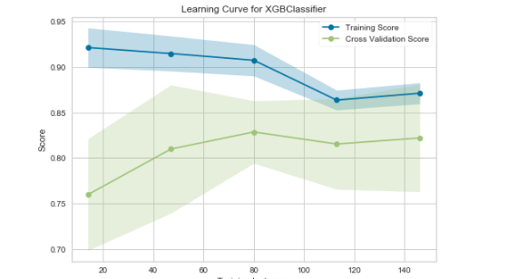
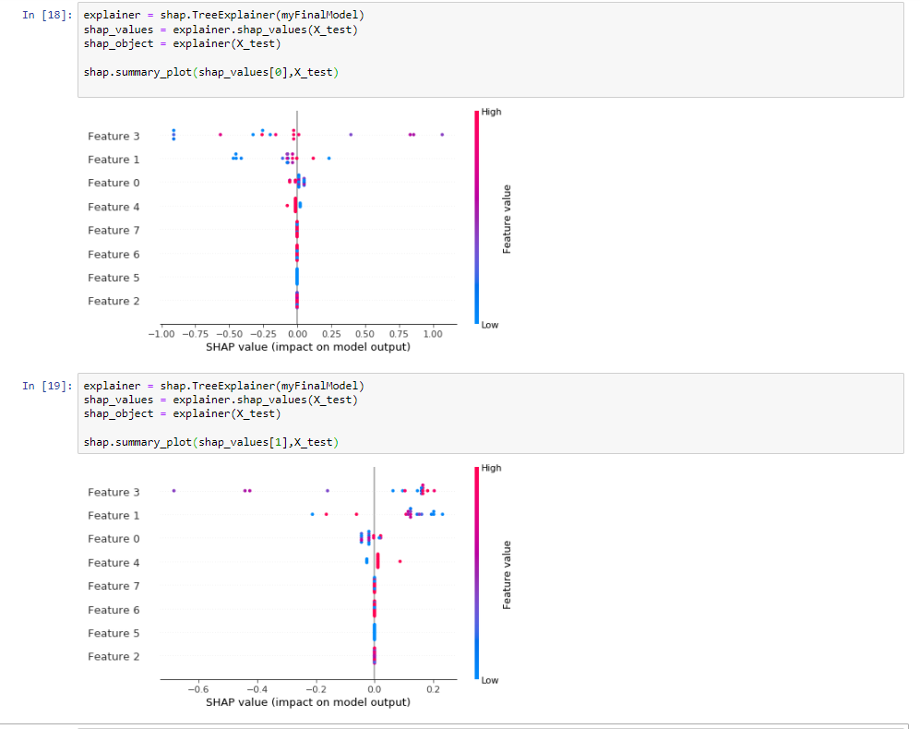
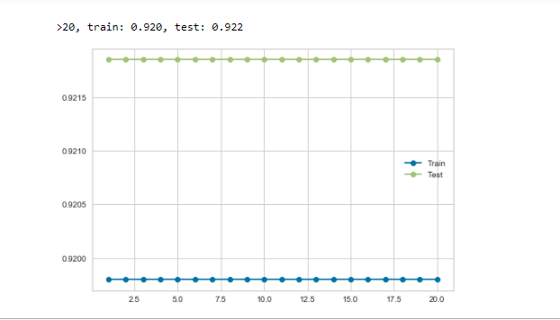
Clinical information only

Slide 12
Clinical plus transport proteins
XGBClassifier(average='macro', base_score=0.5, booster='gbtree',
colsample_bylevel=1, colsample_bynode=1, colsample_bytree=1,
enable_categorical=False, eval_metric='mlogloss', gamma=0,
gpu_id=-1, importance_type=None, interaction_constraints='',
learning_rate=0.300000012, max_delta_step=0, max_depth=7,
min_child_weight=1, missing=nan, monotone_constraints='()',
n_estimators=500, n_jobs=16, num_class=8, num_parallel_tree=1,
objective='multi:softmax', predictor='auto', random_state=1,
reg_alpha=0, reg_lambda=1, scale_pos_weight=None, subsample=1,
tree_method='exact', ...)

Slide 13
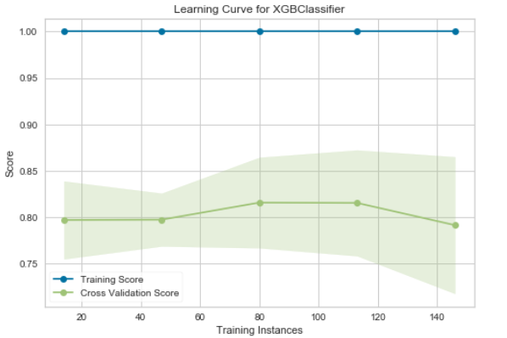
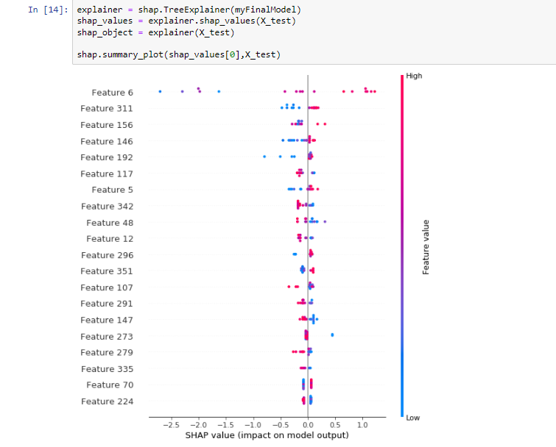
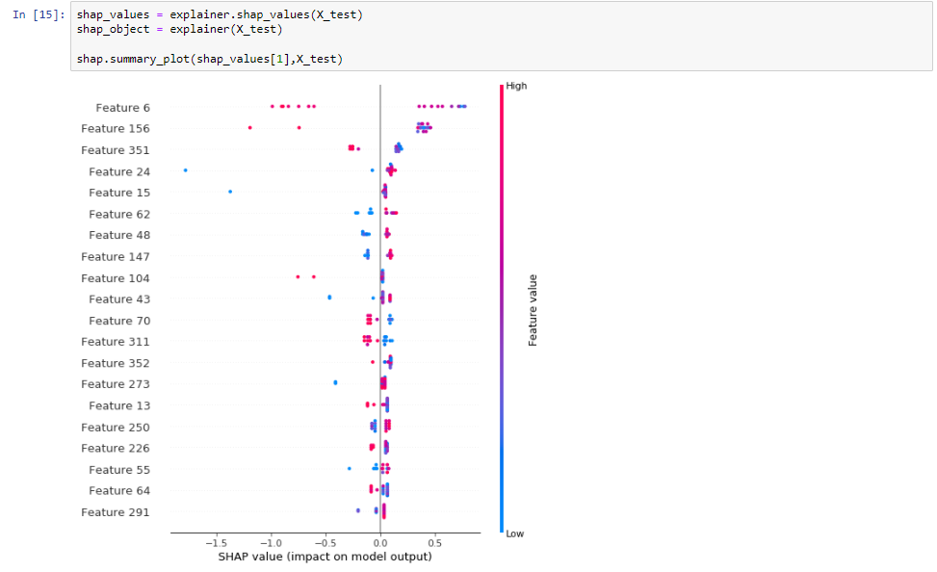
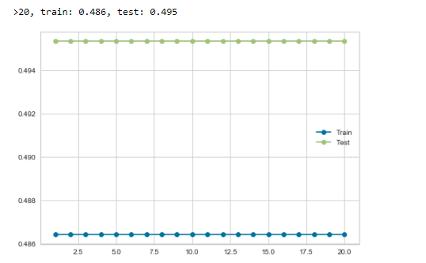
Clinical Information plus Transport protein

Slide 14
Clinical plus apoptosis model
XGBClassifier(average='macro', base_score=0.5, booster='gbtree',
colsample_bylevel=1, colsample_bynode=1, colsample_bytree=1,
enable_categorical=False, eval_metric='logloss', gamma=0,
gpu_id=-1, importance_type=None, interaction_constraints='',
learning_rate=0.300000012, max_delta_step=0, max_depth=3,
min_child_weight=1, missing=nan, monotone_constraints='()',
n_estimators=500, n_jobs=16, num_class=8, num_parallel_tree=1,
objective='multi:softmax', predictor='auto', random_state=1,
reg_alpha=0, reg_lambda=1, scale_pos_weight=None, subsample=1,
tree_method='exact', ...)

Slide 15
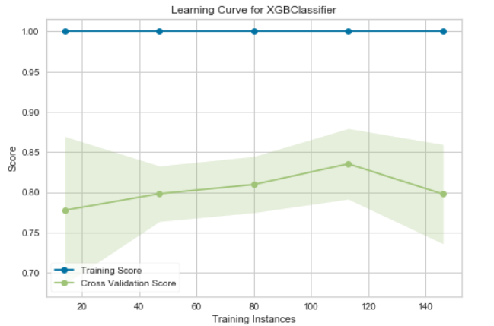
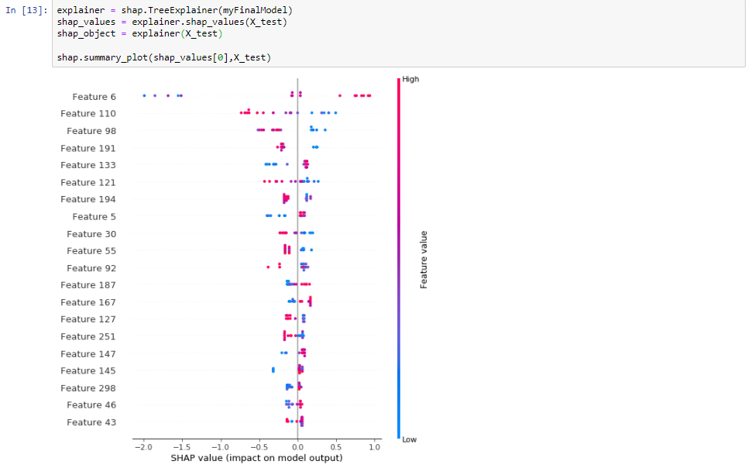
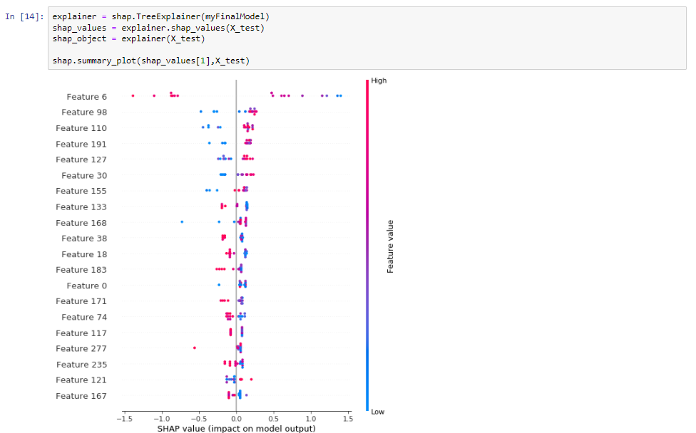
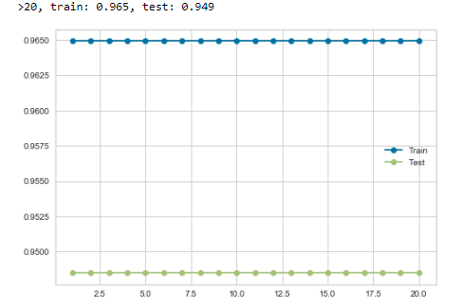
Clinical information plus apoptosis

Slide 16
Model Accuracy
Model | F1 Score
Clinical only | 0.90
Clinical + Transport Proteins | 0.84
Clinical + Positive Regulation of Apoptosis | 0.84

Slide 17
Interesting results
Feature 6 is highlighted as significant contributor in all 3 models.
Represents treatment vs no treatment.
Not significant results.
In clinical only
Feature 3 is days to follow up, significant effect on survival.
Feature 1, and 0(age) had a significant effect on survival.

Slide 18
Interesting results continued
Different genes involved for the two groupings.
Will need to review literature for each of the highest contributors.

Slide 19

Further directions
Filter out
Filter out best predictive genes from each grouping use them and train a new model.
Train
Train model(s) based on different groupings.
Validate
Validate with a different cancer set.

